Slide 1
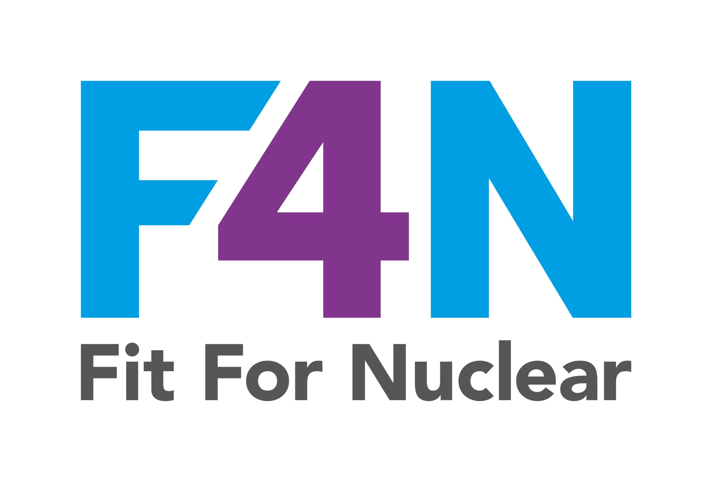


TALK 1 OF 4
Individual Commitment to Safety
Talk 1 of 4: Individual Responsibility, Questioning Attitude, Communication
NucCol | Nuclear Collaboration Ltd · Fit For Nuclear Programme · Commercial in Confidence | 1

Slide 2

What Individual Commitment Means
Three traits make up your individual commitment to nuclear safety: Individual Responsibility, Questioning Attitude, and Communication
These are not abstract ideas. They describe specific things every one of us does, or fails to do, every working day
No system, procedure, or piece of equipment can substitute for an individual who is personally committed to getting it right
Today we will look at what these three traits actually look like in our day-to-day work
These three traits sit alongside six others that make up the full ten-trait nuclear safety culture framework.
NSS-02f | TALK 1 OF 4
NucCol | Nuclear Collaboration Ltd · Fit For Nuclear Programme · Commercial in Confidence | 2

Slide 3
Individual Responsibility
You understand the standards and expectations that apply to your work, and you follow them, not just when someone is watching
You take personal ownership of the quality and safety of what you do
You coach a colleague if you see them cutting a corner, rather than walking past it
You communicate and coordinate with others rather than treating safety as someone else's job
Ask yourself: if everyone in this room worked exactly the way I do, would our nuclear safety standard go up or down?
NSS-02f | TALK 1 OF 4
NucCol | Nuclear Collaboration Ltd · Fit For Nuclear Programme · Commercial in Confidence | 3

Slide 4

Questioning Attitude
Nuclear and radiation technology is complex and can fail in unexpected ways. We never assume it cannot happen here
Success can breed complacency. Just because something worked fine the last fifty times does not mean it is safe the fifty-first time
If you are uncertain, stop. Ask. Get clarity before you carry on
Be willing to question an assumption, even if it means challenging someone more senior than you
A questioning attitude is not the same as being difficult. It is one of the most valued behaviours in the nuclear sector.
NSS-02f | TALK 1 OF 4
NucCol | Nuclear Collaboration Ltd · Fit For Nuclear Programme · Commercial in Confidence | 4

Slide 5

Communication
Use repeat-backs, pre-job briefings, and clear handovers so everyone has a mutual understanding of the task
Self-check your own work against what you intended to achieve before moving on
Use peer checks to challenge your own thinking before you proceed on something significant
Ask questions to validate assumptions rather than guessing what someone meant
Good communication in nuclear work is structured and deliberate, not just 'we had a chat about it'.
NSS-02f | TALK 1 OF 4
NucCol | Nuclear Collaboration Ltd · Fit For Nuclear Programme · Commercial in Confidence | 5

Slide 6
Discussion Scenario
SCENARIO
A colleague asks you to sign off a check that you didn't personally carry out, telling you 'it's basically the same as last time, it'll be fine'.
DISCUSS
What does Individual Responsibility and Questioning Attitude tell you to do here? What would you actually say to your colleague?
NSS-02f | TALK 1 OF 4
NucCol | Nuclear Collaboration Ltd · Fit For Nuclear Programme · Commercial in Confidence | 6

Slide 7
Individual commitment to safety starts with you. Not the procedure. Not the system. You.
NSS-02f | TALK 1 OF 4
NucCol | Nuclear Collaboration Ltd · Fit For Nuclear Programme · Commercial in Confidence | 7

Slide 8
TALK 2 OF 4
Management Commitment to Safety
Talk 2 of 4: Leader Responsibility, Decision-Making, Work Environment
NucCol | Nuclear Collaboration Ltd · Fit For Nuclear Programme · Commercial in Confidence | 8

Slide 9

What Management Commitment Means
These three traits describe what is expected of anyone with leadership or supervisory responsibility, regardless of seniority
This talk applies whether you lead a team of twenty or you are the one person other colleagues naturally turn to for guidance
Leadership in nuclear safety is judged by behaviour, not job title
We will look at what good leadership behaviour looks like, and how every one of us can hold leaders to this standard
If you are not in a formal leadership role, this talk still matters. It tells you what you should expect to see from those who lead you.
NSS-02f | TALK 2 OF 4
NucCol | Nuclear Collaboration Ltd · Fit For Nuclear Programme · Commercial in Confidence | 9

Slide 10
Leader Responsibility
Leaders model the safety behaviours they expect of others. They do not just talk about safety, they demonstrate it
Leaders are present in work areas, asking questions, observing, and listening, not just managing from an office
Leaders make sure people and resources are available to do nuclear work safely, not just available to hit a deadline
Leaders recognise and reward safety behaviour, not just output
A leader who says safety comes first, but always asks about schedule first, is teaching the opposite lesson.
NSS-02f | TALK 2 OF 4
NucCol | Nuclear Collaboration Ltd · Fit For Nuclear Programme · Commercial in Confidence | 10

Slide 11

Decision-Making
Decisions involving risk should be systematic, not based on gut feel or pressure of the moment
The safe choice is chosen over the merely allowable choice. Confirm something is safe before proceeding, not proceed until proven unsafe
Authority for decisions should be clear. Everyone should know who actually has the authority to make a call
When something unexpected happens and no procedure covers it, a measured, prudent approach is taken, not a rushed one
Conservative decision-making is not slow decision-making. It is decision-making that properly accounts for risk.
NSS-02f | TALK 2 OF 4
NucCol | Nuclear Collaboration Ltd · Fit For Nuclear Programme · Commercial in Confidence | 11

Slide 12

Work Environment
Trust and respect should be obvious in how people treat each other day to day
Differing opinions are genuinely welcomed, not just tolerated
Conflicts are resolved fairly and quickly, not left to fester
The physical state of the workplace, tidy, organised, well maintained, reflects respect for the people who work there
A respectful work environment is not a soft add-on to safety culture. It is one of the ten core traits for a reason.
NSS-02f | TALK 2 OF 4
NucCol | Nuclear Collaboration Ltd · Fit For Nuclear Programme · Commercial in Confidence | 12

Slide 13
Discussion Scenario
SCENARIO
A supervisor is under pressure to hit a delivery deadline. A team member flags a concern about a process step, but the supervisor says 'we'll sort it properly next time, let's just get this batch out'.
DISCUSS
Which of the three traits in this talk does this situation touch on? What should the supervisor have done differently?
NSS-02f | TALK 2 OF 4
NucCol | Nuclear Collaboration Ltd · Fit For Nuclear Programme · Commercial in Confidence | 13

Slide 14
Management commitment to safety is proven in the moments when safety and schedule pull in different directions.
NSS-02f | TALK 2 OF 4
NucCol | Nuclear Collaboration Ltd · Fit For Nuclear Programme · Commercial in Confidence | 14

Slide 15
TALK 3 OF 4
Learning and Problem Resolution
Talk 3 of 4: Continuous Learning, Problem Identification and Resolution
NucCol | Nuclear Collaboration Ltd · Fit For Nuclear Programme · Commercial in Confidence | 15

Slide 16

What These Traits Mean
These two traits are about how the organisation as a whole learns and improves, not just individuals
A strong organisation does not wait for a serious event to learn a lesson. It learns from the small things first
Today's talk covers Continuous Learning and Problem Identification and Resolution
Both connect directly to our Near Miss and OPEX Log, which is where we actually capture and act on this learning
These traits explain why we want you to report things, even small things, and why nothing bad happens to you for doing so.
NSS-02f | TALK 3 OF 4
NucCol | Nuclear Collaboration Ltd · Fit For Nuclear Programme · Commercial in Confidence | 16

Slide 17
Continuous Learning
Safety performance is regularly checked, not assumed to be fine because nothing has gone wrong recently
Lessons from inside and outside the organisation are collected, evaluated, and acted on quickly
Training keeps people knowledgeable and competent, not just compliant with a minimum requirement
We benchmark against other organisations, including outside our own sector, to find better ways of working
Every industry alert we receive, every external lesson we hear about, is a chance to check ourselves before it happens to us.
NSS-02f | TALK 3 OF 4
NucCol | Nuclear Collaboration Ltd · Fit For Nuclear Programme · Commercial in Confidence | 17

Slide 18

Problem Identification and Resolution
A low threshold for reporting issues means even minor problems get captured, because minor issues can become major ones
Self-reporting is expected and valued. Reporting your own mistake is not a weakness, it is exactly what should happen
Issues are properly investigated to find the real cause, not just patched over
We look for patterns and trends across multiple reports, not just dealing with each one in isolation
Use the Near Miss and OPEX Log to record anything relevant, however small it feels. That is exactly what it is there for.
NSS-02f | TALK 3 OF 4
NucCol | Nuclear Collaboration Ltd · Fit For Nuclear Programme · Commercial in Confidence | 18

Slide 19
Discussion Scenario
SCENARIO
You notice that a particular tool is regularly slightly out of position on the rack, suggesting it might be getting knocked or used without being properly checked back in. No incident has ever resulted from this.
DISCUSS
Should this be reported? What does Problem Identification and Resolution suggest about minor, repeated observations like this?
NSS-02f | TALK 3 OF 4
NucCol | Nuclear Collaboration Ltd · Fit For Nuclear Programme · Commercial in Confidence | 19

Slide 20
The organisations that learn from the small stuff are the ones that never have to learn from the big stuff.
NSS-02f | TALK 3 OF 4
NucCol | Nuclear Collaboration Ltd · Fit For Nuclear Programme · Commercial in Confidence | 20

Slide 21
TALK 4 OF 4
Raising Concerns and Work Planning
Talk 4 of 4: Raising Concerns, Work Planning
NucCol | Nuclear Collaboration Ltd · Fit For Nuclear Programme · Commercial in Confidence | 21

Slide 22

What These Traits Mean
This final talk covers Raising Concerns and Work Planning, completing all ten traits across the four-part series
Raising Concerns is about whether people genuinely feel safe to speak up, not just whether a process exists on paper
Work Planning is about how we organise and control work so that safety is built in from the start, not bolted on afterwards
Together, these traits close the loop on everything covered in talks one to three
This talk connects directly to our Just Culture Framework, which explains exactly how concerns and errors are handled fairly.
NSS-02f | TALK 4 OF 4
NucCol | Nuclear Collaboration Ltd · Fit For Nuclear Programme · Commercial in Confidence | 22

Slide 23
Raising Concerns
Everyone has the right and responsibility to raise a safety concern without fear of retaliation, intimidation, or being treated differently afterwards
There is a route to raise a concern that does not go through your direct line manager, for situations where that feels difficult
Concerns can be raised in confidence, and will still be investigated and resolved properly
If you raise a concern, you should hear what happened as a result, even if you cannot be told every detail
Find out who the independent contact is in our organisation for raising a nuclear safety concern. Everyone in this room should know.
NSS-02f | TALK 4 OF 4
NucCol | Nuclear Collaboration Ltd · Fit For Nuclear Programme · Commercial in Confidence | 23

Slide 24

Work Planning
Work is planned properly before it starts: identified, scheduled, resourced, and risk-assessed, not just started and figured out as we go
Safety stays the overriding priority throughout the work, not just at the planning stage
Equipment and processes are kept within their proper limits. Those limits are protected, not quietly stretched
After work is finished, we review it. What went well, what didn't, and what should change next time
Rushed planning is one of the most common root causes behind near misses across the whole nuclear sector.
NSS-02f | TALK 4 OF 4
NucCol | Nuclear Collaboration Ltd · Fit For Nuclear Programme · Commercial in Confidence | 24

Slide 25
All Ten Traits: A Quick Recap
Individual Commitment to Safety: Individual Responsibility, Questioning Attitude, Communication
Management Commitment to Safety: Leader Responsibility, Decision-Making, Work Environment
Management Systems: Continuous Learning, Problem Identification and Resolution, Raising Concerns, Work Planning
Ten traits, three categories, one shared purpose: keeping nuclear work safe through everything we do, every day
See the NSS-02a Training Guide for the full detail behind each trait, and NSS-02b to assess where we currently stand.
NSS-02f | TALK 4 OF 4
NucCol | Nuclear Collaboration Ltd · Fit For Nuclear Programme · Commercial in Confidence | 25

Slide 26
Discussion Scenario
SCENARIO
A piece of work is running behind schedule. The supervisor suggests skipping the formal pre-job briefing 'just this once' to save time, since the team has done similar work many times before.
DISCUSS
Which traits from across all four talks does this situation touch on? What would you do if you were on that team?
NSS-02f | TALK 4 OF 4
NucCol | Nuclear Collaboration Ltd · Fit For Nuclear Programme · Commercial in Confidence | 26

Slide 27
Ten traits. Every one of us, every day. That is what a genuine nuclear safety culture looks like.
NSS-02f | TALK 4 OF 4
NucCol | Nuclear Collaboration Ltd · Fit For Nuclear Programme · Commercial in Confidence | 27

